Slide 1
MFL Parents Information Evening 2022/23
Modern Foreign Languages Faculty

Slide 2
Agenda
Review of November exams
Exam structure
Revision techniques
How to support your child’s MFL revision
Boost sessions
Q & A

Slide 3
November exams
3 papers: Reading, Listening and Writing
Papers will cover the covered in year 10 and 11 but also unexpected vocabulary as per requirement of the specification
The summer results showed that for the majority of the students, there is a lack of weekly revision for MFL
MFL revision must be little and often
Words must be revisited 20 times before the brain is able to store them in the long term memory

Slide 4
Exam structure
General vocabulary key for Listening and Reading papers
Grammar and “high level” vocabulary key for Writing and Speaking papers
Listening- 25%
Reading- 25%
Writing - 25%
Speaking - 25%
Writing
Foundation - photocard, 40 words (all present tense), 90 words (three tenses) and translation
Higher - 90 words (3 tenses), 150 words (3 tenses, less guidance), translation
Speaking
Role play, photocard and general conversation

Slide 5
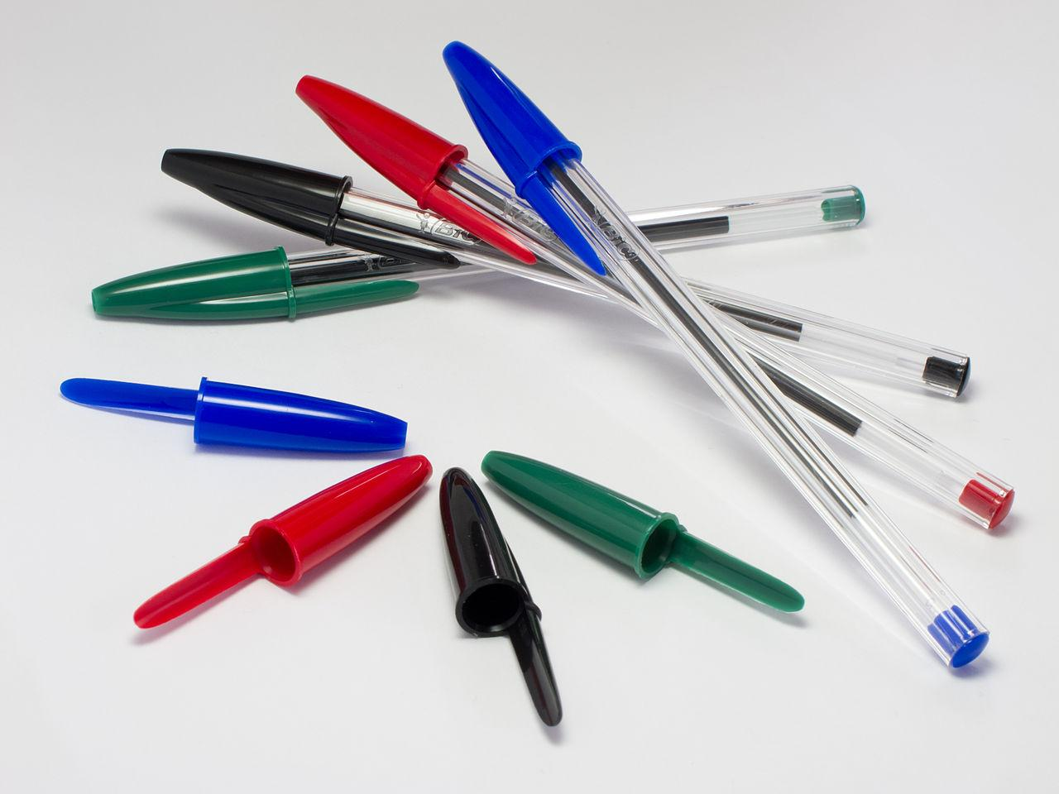
The MFL revision toolkit
This might all sound obvious, but you would be surprised how many people just read through their exercise book when they revise! To be effective, the revision needs to be ACTIVE

Slide 6
Revision techniques
Learning a language is like going to the gym. Yes, it is sometimes very difficult and boring, but after a little bit of hard work we are suddenly fit enough to play our favourite sports.
This is what you’ll find with MFL, sometimes it can be boring, but this is necessary for the fun things that come afterwards.
There is no one way to learn and we often need to use a variety of techniques to fully understand new ideas.

Slide 7
Revision techniques II
Flashcards
Languagenut https://www.languagenut.com/en-gb/
Quizlet https://quizlet.com/en-gb
Vocabulary book
Memrise - https://www.memrise.com/
Grammar revision - tenses
BBC bitesize - https://www.bbc.co.uk/bitesize/subjects/zhsvr82
Reading - foreign newspapers (el país/le monde) or the bbc in French/Spanish
Podcasts - choose their own interest, use GCSE pods
Watch authentic materials
Lupin
Cable girls
Make a study plan

Slide 8
WEEKLY REVISION PLAN
WEEK:
VOCABULARY:
Day
SOMETHING NEW I’VE LEARNED THIS WEEK:
GRAMMAR:
Day
WRITING:
Day
HOMEWORK:
………………………………………………………………………………………………...
SPEAKING:
Day

Slide 9
WEEKLY REVISION PLAN
WEEK:
20/11/2021
VOCABULARY:
Day- Monday
SOMETHING NEW I’VE LEARNED THIS WEEK:
De vez en cuando- from time to time
Verbs do not have gender
Revise Free time activities. Use languagenut
GRAMMAR:
Day - Wednesday
Present. Learn endings and time phrases. Use Flashcards.
WRITING:
Day Friday
Write 50 words: What do you normally do in your free time? Send to teacher
HOMEWORK:
Day Sunday
………………………………………………………………………………………………...
SPEAKING:
Focus on Photocard. Free time. Describe photo card. Record on my phone and listen to it again

Slide 10
Vocabulary learning
The vocabulary lists for the 8 chapters of the textbook are uploaded in all google classrooms

Slide 11
Learning vocabulary tips
Write your words on post-its and stick them up around your room.
Colour code! By gender / tense / difficulty level / however you like!
Write a mnemonic to help you with difficult spellings.
Play word association or “last letter first letter”
Make flash cards – print out a blank table from Word and cut out the rectangles. Write the French (etc) on one side and the English on the other.
Break long words down into smaller parts to make them more manageable.

Slide 12
Make a silly sentence up in English and include the word you are trying to learn. “I want to eat some lovely mashed pomme de terre”
Tap out the rhythm of words or groups of words.
Record words and spellings onto your phone or make an MP3 and listen to it on your headphones.
Make a difficult word your phone background for a week
Make a Wordle word cloud and take a screenshot (www.wordle.net )
Make up a song using the words you are trying to learn (the more ridiculous the better), or try singing the words to an existing song.

Slide 13
You can either do two sets, one with the MFL and the other with the English…..
Or you can do one set of cards with the MFL on the front and English on the back.
First make your cards…..
Don’t forget, the words on your cards can be colour coded too!
With two sets, you can play pairs…. turn the cards face down and pick them up in twos until you get pairs.
Parque | Iglesia | Estación | Ayuntamiento | Correos
Supermercado | Tienda | Panadería | Edificio | Casa
Test yourself, putting the cards into a ‘right’ and ‘wrong’ pile until the ‘wrong’ pile is non existent!
Get someone to test you from your cards.

Slide 14
Grammar revision
All students must be able to talk/write in present, past and future in order to pass the writing and speaking exams
Students must be confident when mixing the tenses and changing the verbs/actions words to speak in the different time frames (today, yesterday and tomorrow)

Slide 15
Revise your infinitives (to do/to live/to talk) like you would revise other items of vocabulary.
Learn to recognise the tense of the verbs
Write the present, past and future forms of a verb, with the root in one colour and the ending in a different one
Learn the verb endings.
It’s not just verbs which are important! Revise the time phrases - yesterday, last year, next year, two years ago...

Slide 16
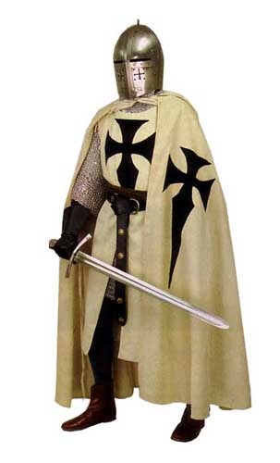
Create tenses timelines and write out verbs / sentences in each of the tenses……
Present
Past
Future
J’ai joué au foot.
Je joue au foot.
Je vais jouer au foot.

Slide 18
How to support your child’s revision
Use flashcards to test their vocabulary knowledge
Ask them to teach you a new French/Spanish word every day
Ask them to read you an extract in the language outloud
Test if they are able to change a verb/action word into the three time frames correctly

Slide 19
Boost sessions
Sessions will start after half term - Thursdays 3-3.45pm- all students welcome
SOW will be shared at the end of the presentation

Slide 21
Next exams
November exams - Listening, reading and writing
January exams - Listening, reading and writing
February - speaking mocks - questions will be shared in lessons in the next months

Slide 22
Any questions?

