Slide 1

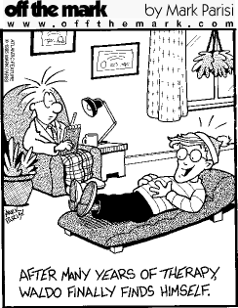
What is Psychology?

Slide 2
What is Psychology?
The scientific study of behavior and mental processes and how they are affected by an organism’s physical, state, mental state, and external environment.
Scientific study requires several things:
Theoretical framework
Testable Hypotheses
Empirical evidence

Slide 3
What kind of student is this course suitable for?
1. Has an interest in or curiosity about people.
2. Has an interest in understanding some of the mental processes and experiences underlying human behaviour.
3. Has a desire to work consistently hard throughout the course.
4. Can think critically using theories and evidence to explain psychological concepts.
5. Should be able to demonstrate excellent knowledge and skills in English, Maths and Science and Humanities.

Slide 4
Why choose Psychology?
Are you interested in the following?
How the human memory works?
How do early attachments influence our future relationships?
Why do we conform and obey?
Why do people suffer from OCD, Phobias and Depression?
How does the brain relate to human behaviour?
How do psychologists plan, carry out, analyse and evaluate research?
How do we use qualitative and statistical data to make inferences about human behaviour?
Why do people commit crimes?
Why do romantic relationships break down?
Why do people suffer from Schizophrenia?
Is our behaviour innate or due to the environment?
Do we choose to behave in a certain way (free will) or is it due to other factors (determinism)?
If you are interested and can cope with the workload - choose Psychology!

Slide 5
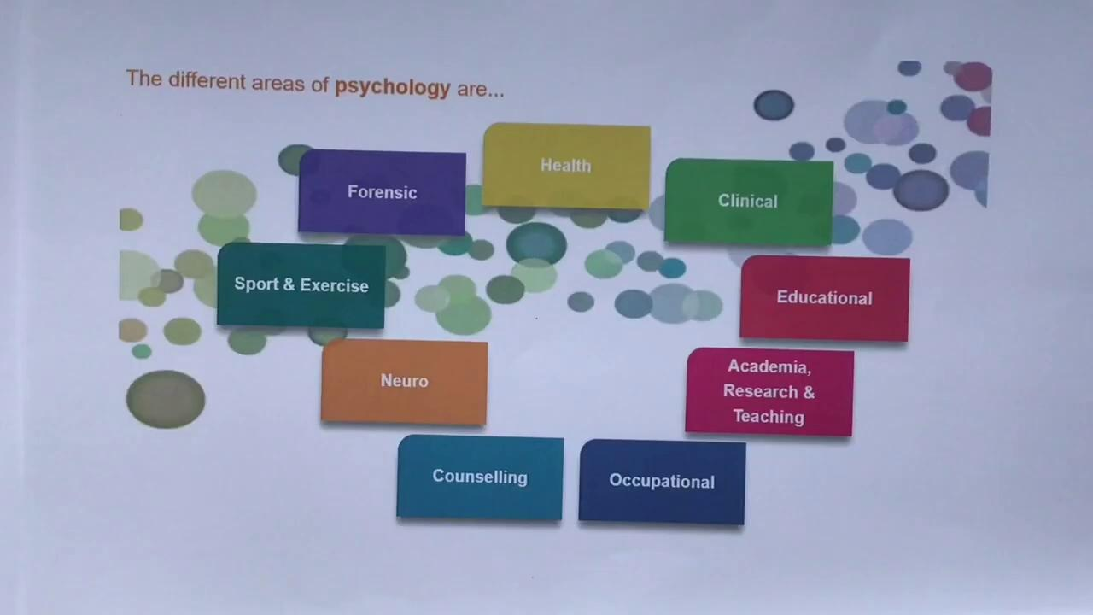

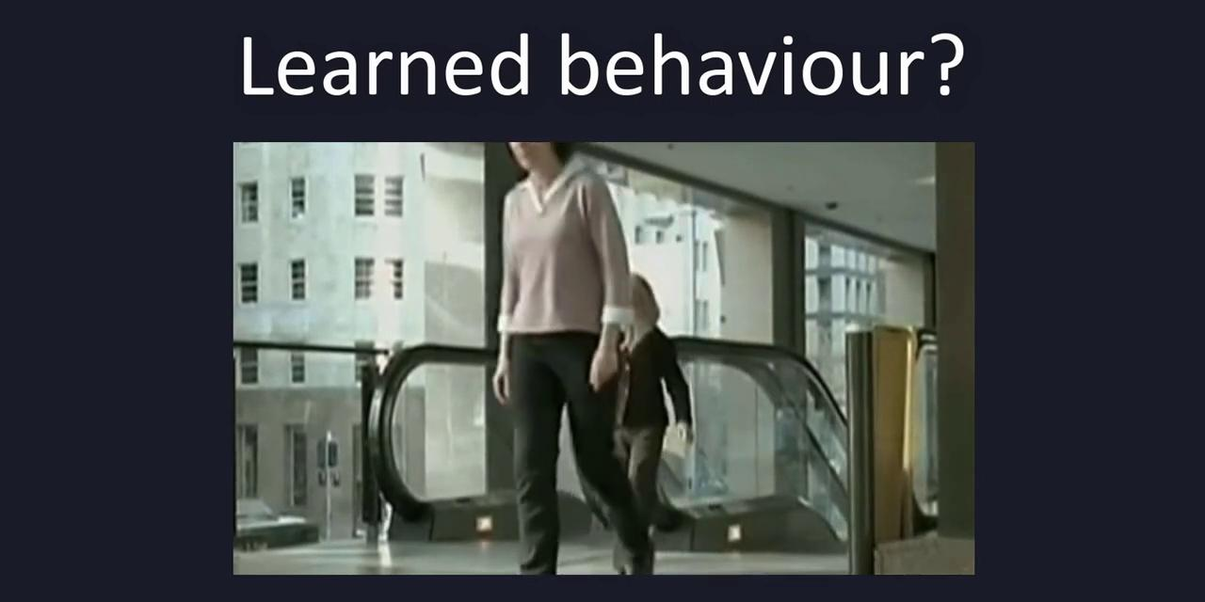
VIDEOS: Why choose A Level Psychology?

Slide 6
Why do I need to meet the grade requirements?
100% examinations and NO controlled assessments.
English Language and English Literature - Grade 5 or above.
Maths - Grade 5 or above
GCSE Combined Science or Separate Sciences - Grade 5 or above

Slide 7
Why do you need these subjects?
100% examinations and no controlled assessments.
English Language and English Literature Grade 5 – Essay based subject which requires a lot of reading, describing, analysing and evaluating text.
Mathematics Grade 5 there is large amount of statistics covered in the psychology specification over two years.
GCSE Combined Science/Separate Sciences Grade 5 – analyse and evaluate studies, needed to understand Biological approaches and Biopsychology, use research methods to analyse psychological studies.

Slide 8
Where can this course lead me?
You can go on to University to study a range of courses, including medicine, law and psychology. Psychology provides a good foundation for or route to many professions and occupations including teaching, medicine, legal, forensic, occupational, educational and clinical psychology, psychotherapy, nursing, social work, and childcare.
There are opportunities for work in the police, journalism, special schools, children's hospitals and homes, counselling, health and sports psychology and work in offices, retailing, advertising, market research and a range of large and small organisations and corporations etc.

Slide 9
Careers
Kinds of Psychologists (look at noticeboard in S5) or https://www.bps.org.uk/find-your-career-psychology
Health
Clinical
Educational
Academia
Occupational
Cognitive Neuroscience
Counseling
Forensic
Occupational
Sport

Slide 10
What will be studied in Year 1?
Specification link (AQA): https://www.aqa.org.uk/subjects/psychology/a-level/psychology-7182/specification/specification-at-a-glance
Memory | Attachment | Social Influence
How memory works and the everyday applications of the importance of memory. | Importance of attachment between infants and their primary caregiver. | Why do we obey authority figures? Why do we conform?
Approaches | Research Methods | Psychopathology
Learning about the origins of psychology. | Methods and techniques. Investigation design, data analysis and presentation. | Defining psychological abnormality. Therapies used to treat abnormality.

Slide 11
What will be studied in Year 2?
Paper 2 & 3 content
Approaches Biopsychology Research Methods
Schizophrenia | Relationships | Forensic Psychology
Includes the description and explanations of schizophrenia and applications of models to the diagnosis of this disorder. | Includes explanations for the formation, maintenance and breakdown of romantic relationships. | Includes looking at criminal profiling and explanations for offending behaviour.

Slide 12
Examinations
How will I be assessed?
Students will be expected to complete regular assignments throughout the course for class and homework and whole school mock exams.
A Level Examination
Paper 1: 2 hour paper Topics 1 – 4, 96 marks
Paper 2: 2 hour paper Topics 5 – 7, 96 marks
Paper 3: 2 hour paper Topic 8 and Relationships, Schizophrenia, Forensic Psychology 96 marks.
No controlled assessments, 100% Examination.

Slide 13
Who to contact for more info?
Head of Psychology - Ms Bheekoo
I can be found in the Science office or S5 which is located in the 6th form corridor.
You can also email me:
shelina.bheekoo@winchmore.enfield.sch.uk

