Slide 1
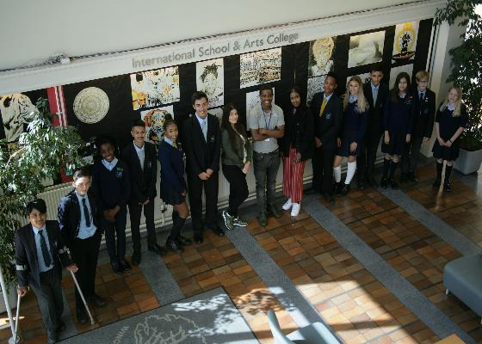
Winchmore School, London, UK
The Gymnasium School named after
N.M Przhevalsky, Smolensk, Russia
Making a Partnership, December, 2019

Slide 2
Freezing cold and very Christmassy in Moscow!
Led by Mr Noel Thompson, Deputy Head teacher and International School’s Director, a delegation of teachers from Winchmore School visited Moscow and Smolensk in December, 2019.
The intention was to set up a partnership between Winchmore School and the Gymnasium School, named after N.M Przhevalsky, in Smolensk

Slide 3
Taking the ‘sleeper’ train from Moscow to Smolensk
Arriving in Smolensk as dawn breaks

Slide 4
Programme for the visit
Wednesday 4th December
12.00 Welcome and introductions
12.30 Power Point Presentation
1.00 Discussion
1.30 Signing ceremony
(Memorandum of Understanding)
2.00 Lunch and departure
Thursday 5th December
10.00 Arrival
11.30 Lesson with Winchmore’s Mr.Izotov
12.00 Observe Music Lesson
12.30 Visit school museum
1.00 Lunch with Gymnasium teachers
2.00 Excursion and sight seeing in town
3.00 Departure
6.00 Farewell dinner at Veranda Hotel

Slide 5
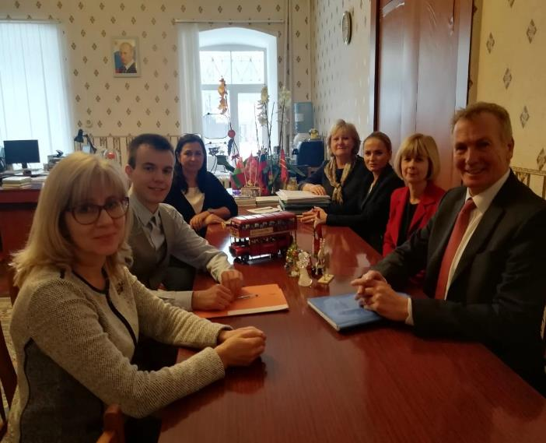
Signing the Memorandum of Understanding and Exchanging gifts
Staff from both schools met together to sign the Memorandum of Understanding which outlined what we hope to achieve from our partnership. This will help to ensure more opportunities for students and staff to develop links. To explore differences in lifestyle, culture and tradition and, naturally, to enrich our language experiences.

Slide 6
Main Aims included in the Memorandum of Understanding
To explore and establish a school partnership
To explore opportunities for a student exchange programme
To promote friendship and understanding of our countries
To explore opportunities in education, culture, business, arts and science

Slide 7
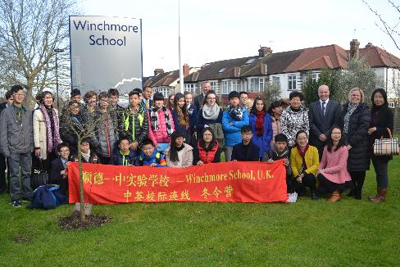
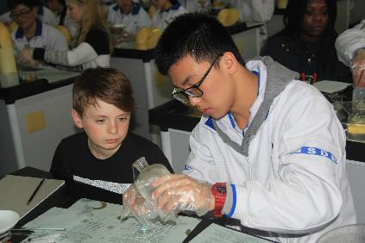
Some advantages of being part of an international network of schools based on the Winchmore experience

Slide 8
An outward-looking, forward thinking and progressive school
Winchmore students reach out to New York
USA

Slide 9
Promoting peace, tolerance, fairness and celebrating diversity together
Students from Winchmore working in harmony with students from our partner school in Shunde, near Hong Kong

Slide 10
Adopting an international approach for finding solutions to global concerns
Sharing different ways of teaching and learning.
Exploring global warming, sustainability, pollution and making the most of natural resources

Slide 11
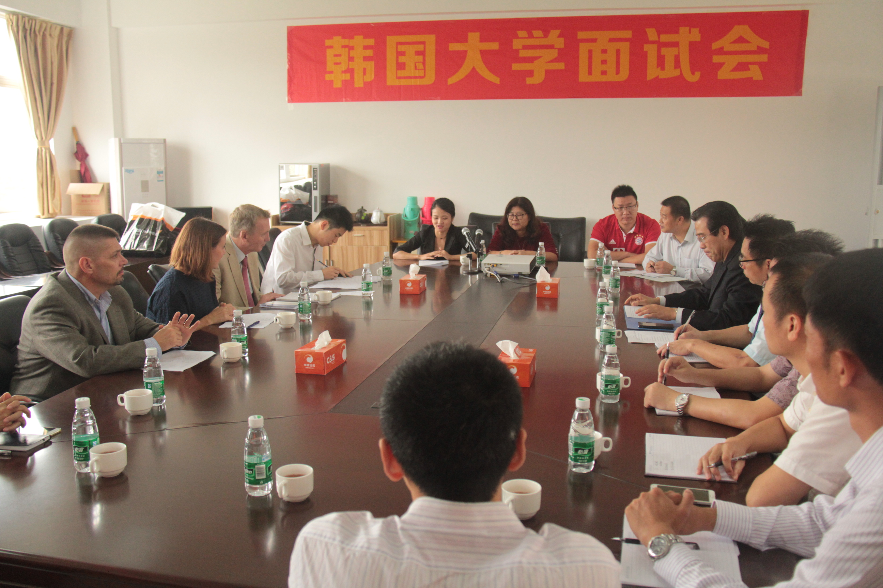
Professional development opportunities for staff
Team leaders meet to compare notes.
Different ways of teaching, learning and assessing students
Training opportunities for teachers
Establishing values, culture and the best behaviour for larning

Slide 12
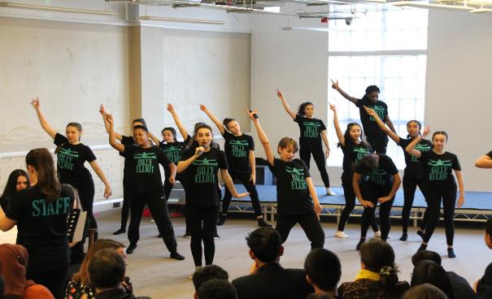
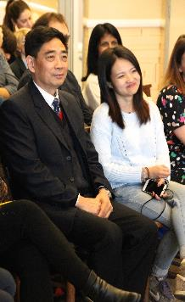
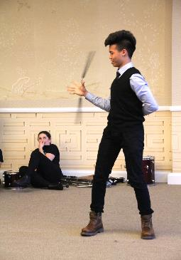
An ambassador school which puts communication and foreign language learning at its heart
Winchmore and Shunde students perform to each other at the China Exchange, in Soho, central London

Slide 13
For inviting us and for sharing ideas and opportunities, with such warmth and affection. We have great memories of our visit and we look forward seeing you in London soon.

