Slide 1
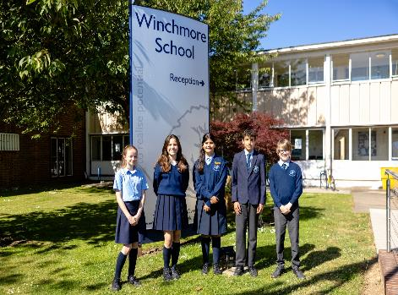
Winchmore School, London, UK
San Vicente De Paul, Murcia, Spain
Student
ExchangeVisit
June 2022

Slide 2
The group included fifteen students and four members of staff….
and the weather was scorching hot!

Slide 3
Covid restrictions prevented the students meeting face to face.
Videocalls provided direct ‘on-line’ communication.
Winchmore students were able to talk about and compare notes with our Spanish students.
Their discussions were based on a wide range of activities and places visited in the area.

Slide 4
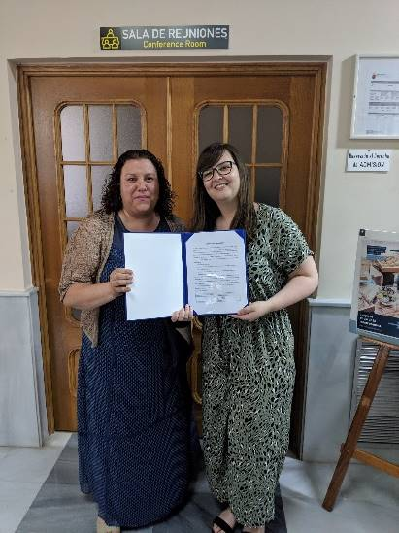
Signing the Memorandum of Understanding
Staff from both schools met together to produce the Memorandum of Understanding which outlined the progress made in our partnership so far, and what we hope to achieve in the future. This will help to ensure more opportunities for students and staff to develop links. To explore differences in lifestyle, culture and tradition and, naturally, to enrich our language experiences.

Slide 5
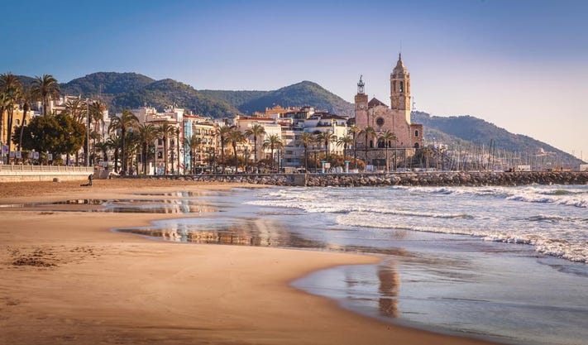
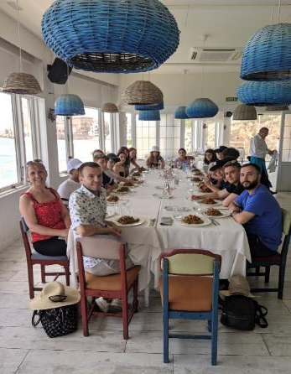
On the way to Barcelona we enjoyed a short detour to the picturesque,
seaside town of Sitges
Well known for its art, architecture, fashion and festivals.
The students enjoyed some games on the beach and a delicious paella… with breath-taking views!

Slide 6
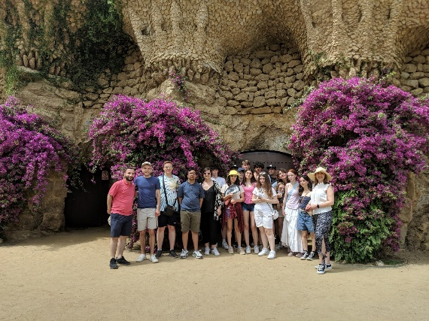
From Murcia to Sitges to Barcelona
We visited the famous landmarks in Barcelona such as the Sagrada Familia, the Gaudi Gardens, the Parc Guell, and of course Las Ramblas.
This gave everyone lots to talk about….in Spanish!

Slide 7
Postcards from Las Ramblas and close by

Slide 8
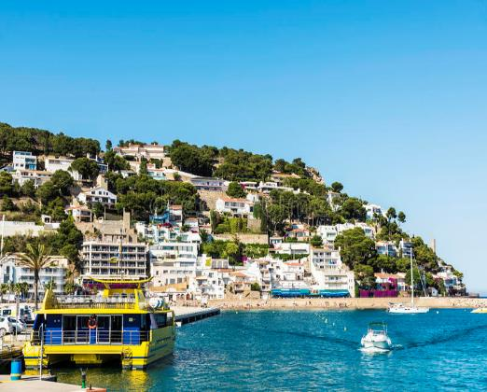
Rounding off the adventure
In the coastal village L’estartit
Near the City of Gerona

Slide 9
Building on our Murcia experience, a number of students would be taking their examinations on their return to school. The days were carefully time-tabled for revision across all subjects.
However, the focus remained on Spain and speaking Spanish. At set meal times mobile phones were discouraged and communicating in Spanish was strongly encouraged.

Slide 10
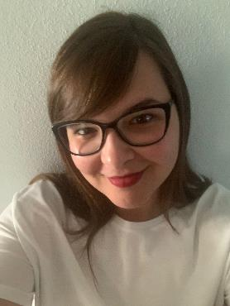
A message from Ms Peon, Head of Modern Foreign Languages at Winchmore School
Thank you to all the staff involved in our Summer visit to Murcia. They were amazing and made sure that everything ran safely and smoothly.
Thank you to the students for their enthusiasm, outstanding behaviour, and living up to the school values of courtesy, commitment, contribution and cooperation. They were a credit to, and excellent ambassadors for, Winchmore School.
Thankyou to the parents and carers for their enthusiasm and encouragement.
Thank you to all the students and staff at San Vicente de Paul, our partner school in Murcia, for their kindness, hospitality and friendship.
Finally, thank you to everybody who helped and supported this amazing opportunity. See the next and final slide to see what Ofsted had to say soon after our return to school.

Slide 11
‘There is a strong sense of community within this school. Leaders offer their pupils a wide range of enrichment clubs and educational visits. They make sure that all pupils make the most of these opportunities’. Winchmore School Ofsted Report, September 2022
Winchmore School bringing textbooks to life

