Slide 1
Winchmore School visits New York July 2022

Slide 2
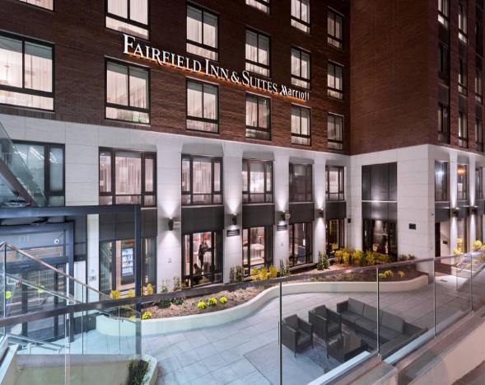
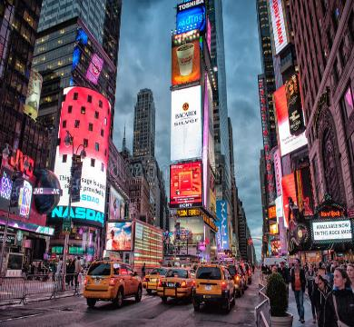
Hotel on the edge of Central Park
Times Square

Slide 3
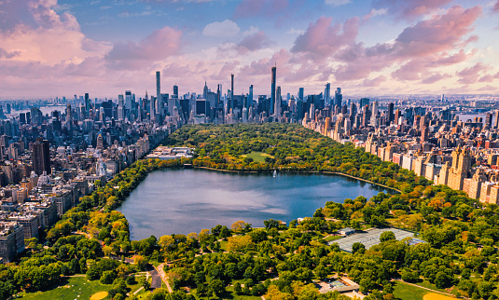
Spending time in Central Park

Slide 4
At Winchmore we believe ‘reading and writing floats on a sea of words’. The adventure of being in New York stirred up an ocean of words which inspired writing, music, art, drama, dance and so much new learning which continued long after our return to London.

Slide 5
Columbus Circle A Golden Gateway to Adventure

Slide 6
On the way to the Statue of Liberty

Slide 7
On the way to Beetlejuice on Broadway

Slide 8
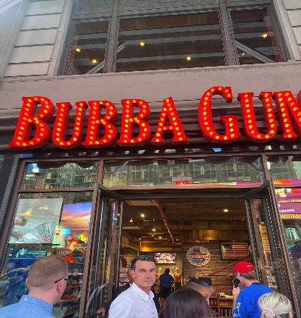
Before Beetlejuice dining at Bubba Gumps in Times Square

Slide 10
All together After the Show

Slide 11
Visiting the Intrepid Air and Space Museum

Slide 12
Fun at the Fair at Coney Island Beach

Slide 13
…or, how about a little volley ball between friends

Slide 14
Packing up and back to Central Park

Slide 15
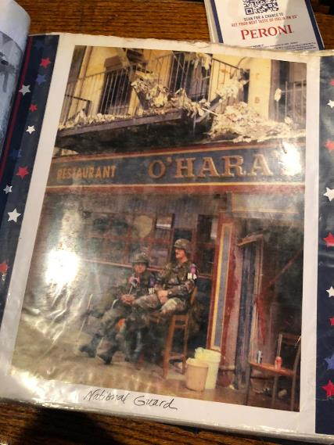
9 / 11 Memorial at Ground Zero

Slide 16
Farewell Dinner The Mykonos Bleu Rooftop Restaurant

